Slide 1
Introduction to Weka
Practical Issues

Slide 2
Many Tools
no single machine learning scheme is appropriate to all data mining problems
real datasets vary, and to obtain accurate models the bias of the learning algorithm must match the structure of the domain
Data mining is an experimental science.

Slide 3
WEKA: the software
Waikato Environment for Knowledge Analysis
Collection of state-of-the-art machine learning algorithms and data processing tools implemented in Java
Support for the whole process of experimental data mining
  Preparation of input data
  Statistical evaluation of learning schemes
  Visualization of input data and the result of learning
Used for education, research and applications

Slide 4
WEKA
Weka was developed at the University of Waikato in New Zealand,
The name stands for Waikato Environment for Knowledge Analysis.
Outside the university the weka, pronounced to rhyme with Mecca, is a flightless bird with an inquisitive nature found only on the islands of New Zealand.

Slide 5
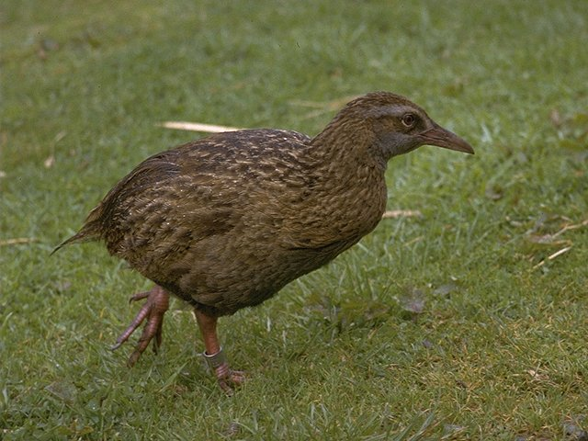
Weka: the bird
Copyright: Martin Kramer (mkramer@wxs.nl)

Slide 6
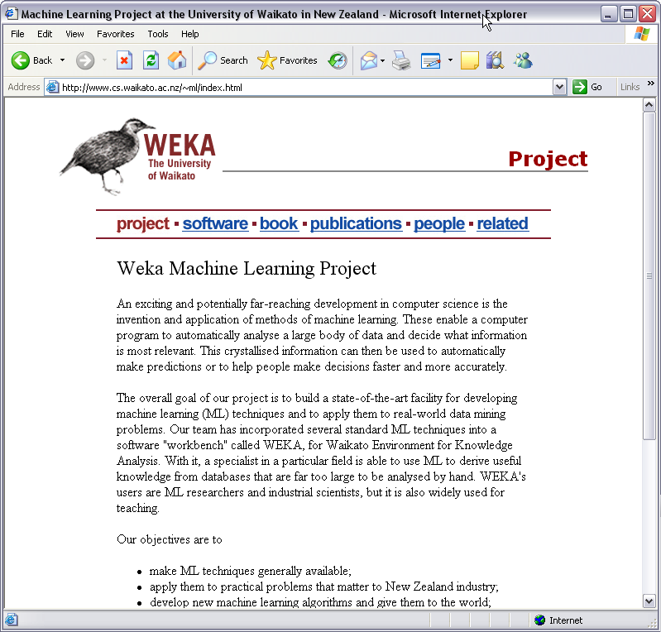

Slide 7
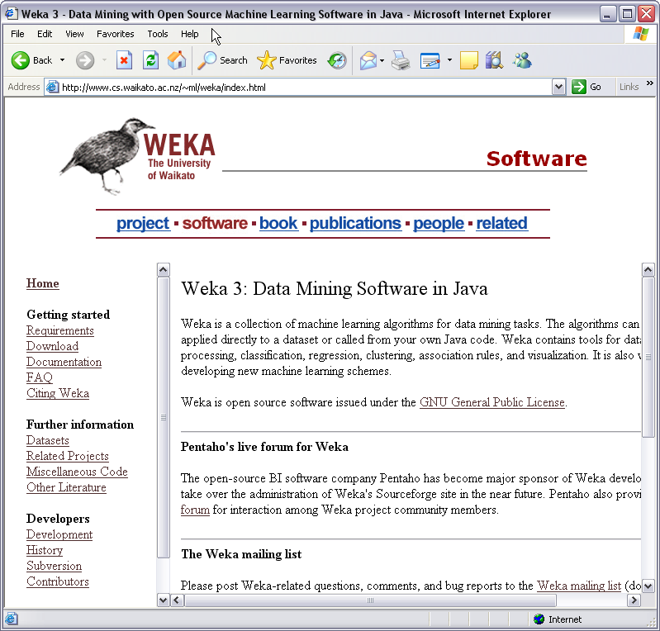

Slide 8
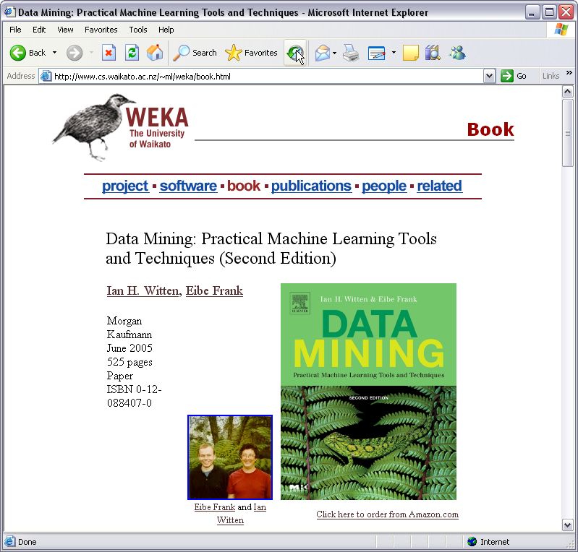

Slide 9
Main Features
49 data preprocessing tools
76 classification/regression algorithms
8 clustering algorithms
15 attribute/subset evaluators + 10 search algorithms for feature selection
3 algorithms for finding association rules
3 graphical user interfaces
  “The Explorer” (exploratory data analysis)
  “The Experimenter” (experimental environment)
  “The KnowledgeFlow” (new process model inspired interface)

Slide 10
Ana giriş
Exprimenter vb işlevleri

Slide 11
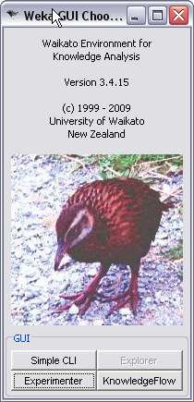
Four Interfaces:
  Simple CLI
  Explorer
  Experimenter
  Knowledge Flow

Slide 12
Interfaces
Explorer: The easiest way to use Weka is through a graphical user interface
The Knowledge Flow : allows you to design configurations for streamed data processing.
  Explorer is that it holds everything in main memory—when you open a dataset, it immediately loads it all in. This means that it can only be applied to small to medium-sized problems. However,Weka contains some incremental algorithms that can be used to process very large datasets.

Slide 13
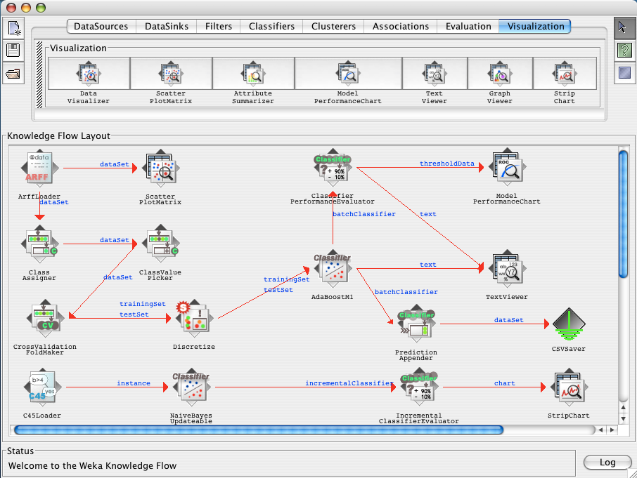
KnowledgeFlow: process flows

Slide 14
Interfaces
Experimenter: designed to help you answer a basic practical question when applying classification and regression techniques:
  which methods and parameter values work best for the given problem?
This workbench was to provide an environment that enables Weka users to compare a variety of learning techniques.
  This can be done interactively usingthe Explorer. However, the Experimenter allows you to automate the process by making it easy to run classifiers and filters with different parameter settings on a corpus of datasets, collect performance statistics, and perform significance tests.

Slide 15
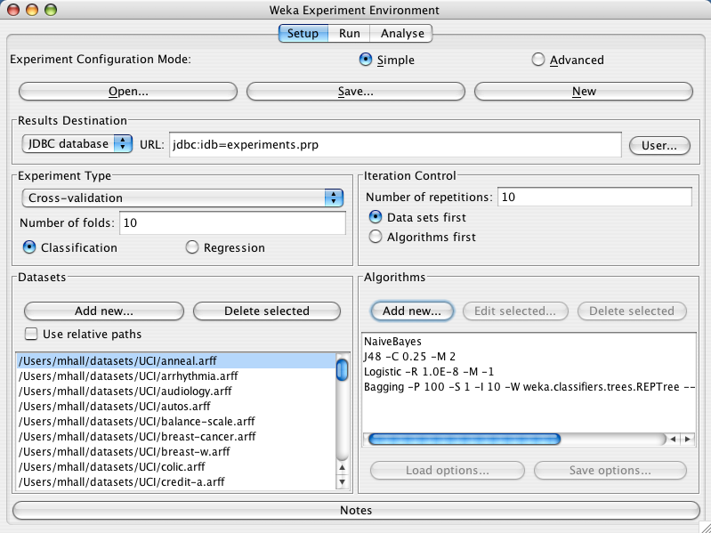
Experimenter

Slide 16
The Explorer: Panels
1. Preprocess: Choose the dataset and modify it in various ways.
2. Classify: Train learning schemes that perform classification or regression
and evaluate them.
3. Cluster: Learn clusters for the dataset.
4. Associate: Learn association rules for the data and evaluate them.
5. Select attributes: Select the most relevant aspects in the dataset.
6. Visualize: View different two-dimensional plots of the data and interactwith them.

Slide 17
Preprocess Panel
The preprocess panel is the start point for knowledge exploration.
By this panel:
  load datasets
  browse the characteristics of attributes
  apply any combination of Weka's unsupervised filters to the data.

Slide 18
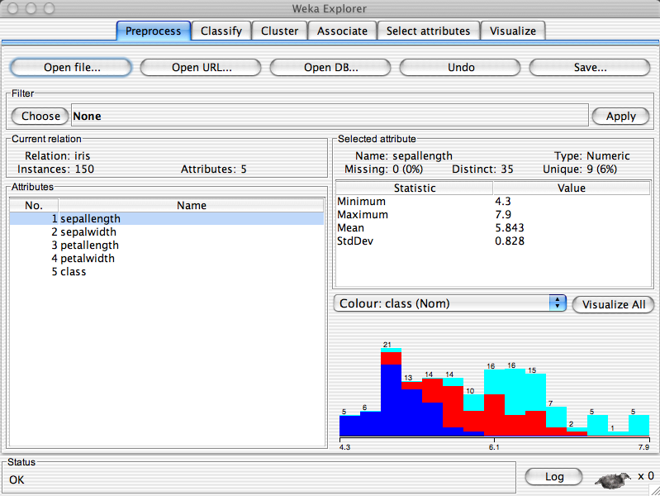
Preprocess Panel

Slide 19
Classifier Panel
The classifier panel allows you to configure and execute any of the weka classifiers on the current dataset.
You can choose to perform a cross validation or test on a separate dataset.
Classification errors can be visualized in a pop-up data visualization tool.
If the classifier produces a decision tree it can be displayed graphically in a pop-up tree visualizer.

Slide 20
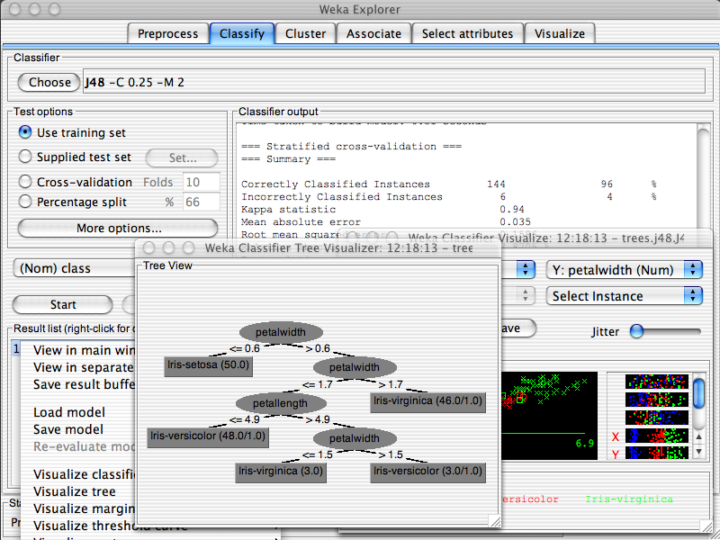

Slide 21
Cluster Panel
From the cluster panel you can configure and execute any of the weka clusterers on the current dataset.
Clusters can be visualized in a pop-up data visualization tool.
When clustering, Weka shows the number of clusters and how many instances each cluster contains.

Slide 22
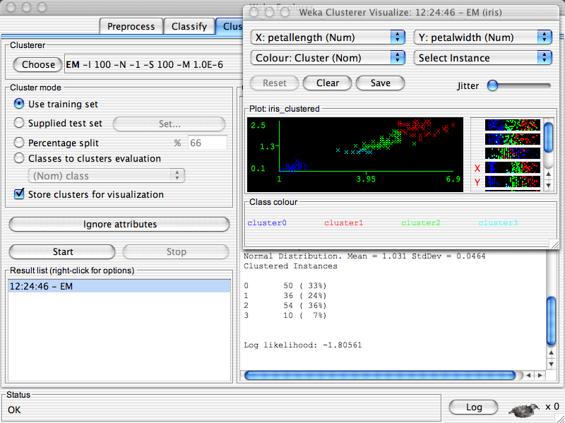

Slide 23
Associate Panel
From the associate panel you can mine the current dataset for association rules using the weka associators.
Weka contains only three algorithms for determining association rules
and no methods for evaluating such rules.

Slide 24
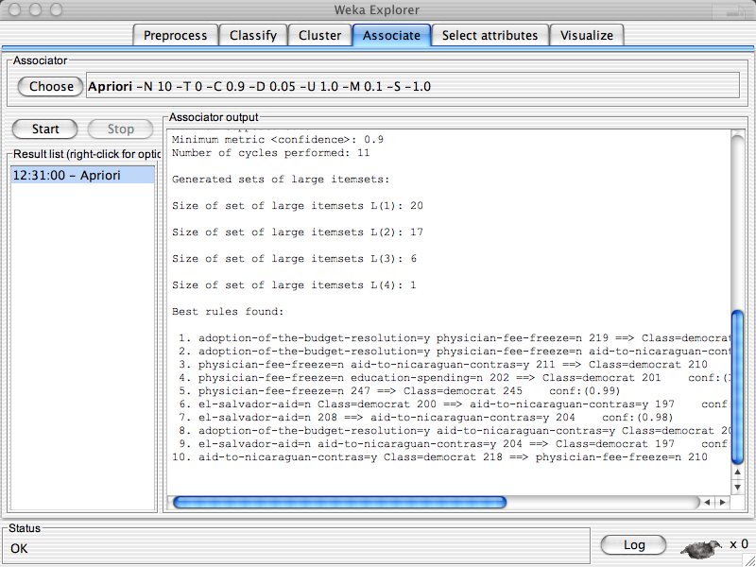

Slide 25
Select Attributes Panel
This panel allows you to configure and apply any combination of weka attribute evaluator and search method to select the most pertinent attributes in the dataset.
The Select attributes panel gives access to several methods for attribute selection.

Slide 26
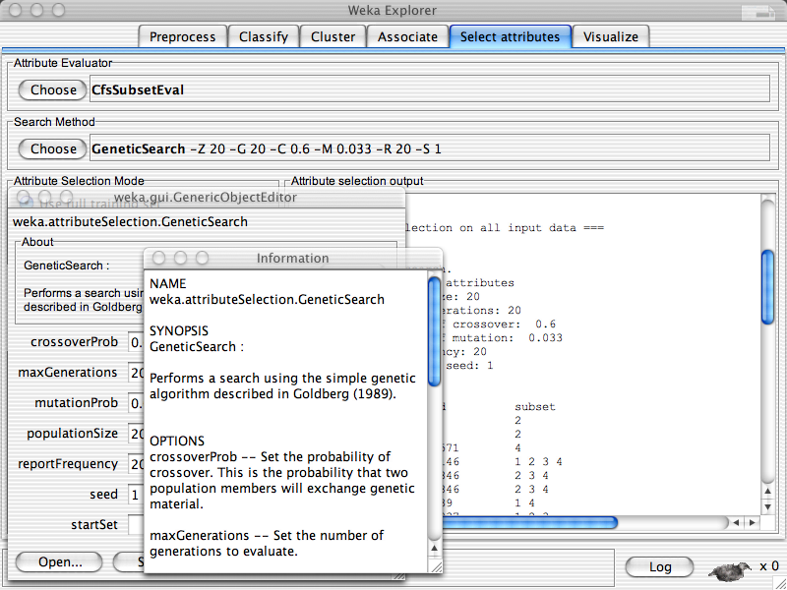

Slide 27
Visualize Panel
This panel displays a scatter plot matrix for the current dataset.
The Visualize panel helps you visualize a dataset—not the result of a classification or clustering model, but the dataset itself.
It displays a matrix of wodimensional scatter plots of every pair of attributes.
Changes in the controls do not take effect until the Update button is clicked.

Slide 28
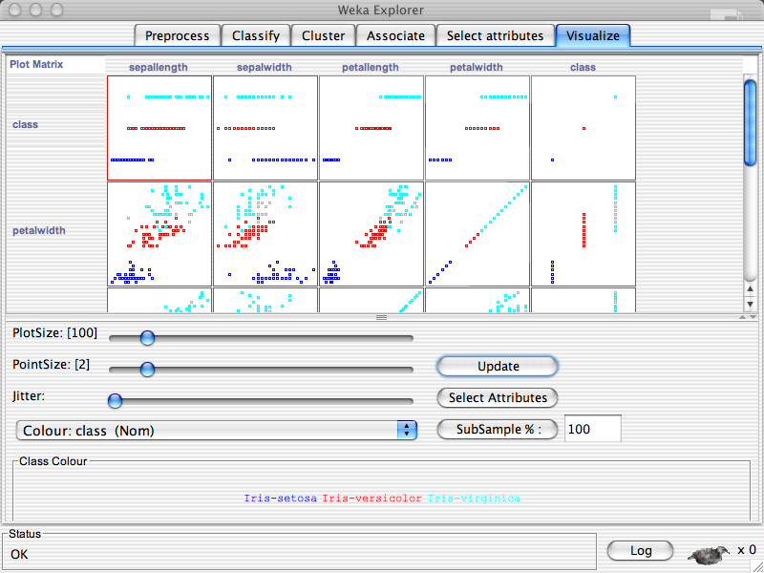

Slide 29
Preparing Data
The data is often presented in a spreadsheet or database.
However,Weka’s native data storage method is ARFF format
You can easily convert from a spreadsheet to ARFF.
The bulk of an ARFF file consists of a list of the instances, and the attribute values for each instance are separated by commas

Slide 30
Instances & Attributes
The input to a machine learning scheme is a set of instances.
Term instances to refer to the input.
Each individual, independent instance that provides the input to machine learning is characterized by its values on a fixed, predefined set of features or attributes.

Slide 31
Instances & Attributes
The value of an attribute for a particular instance is a measurement of the quantity to which the attribute refers.
  Numeric attributes, sometimes called continuous attributes, measure numbers—either real or integer valued.
  Nominal attributes take on values in a prespecified, finite set of possibilities and are sometimes called categorical.
    nominal, ordinal, interval, and ratio.

Slide 32
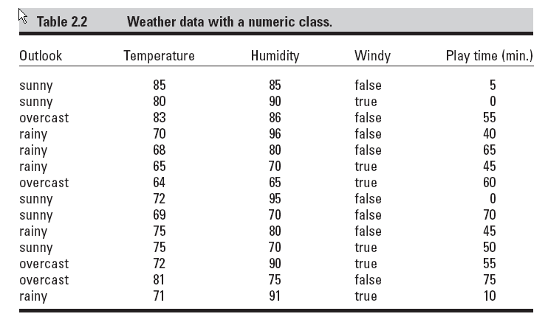
Weather Data

Slide 33
Preparing the Input
Weka uses a particular input file format: the attribute-relation file format
(ARFF format)
.arff extension
Converting files to ARFF
  Weka has three file format converters
  for spreadsheet files with the extension .csv,
  for C4.5’s native file format with the extensions .names and .data,
  For serialized instances with the extension .bsi.

Slide 34
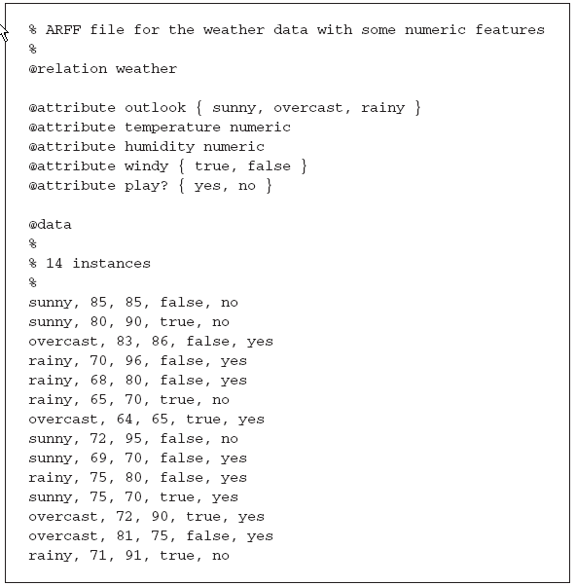

Slide 35
Preparing the input
Lines beginning with a % sign are comments.
At the beginning of the file are the name of the relation (weather) and a block defining the attributes (outlook, temperature, humidity, windy, play?)
Nominal attributes are followed by the set of values they can take on, enclosed in curly braces.
Values can include spaces; if so, they must be placed within quotation marks.
Numeric values are followed by the keyword numeric.

Slide 36
@data line that signals the start of the instances in the dataset.
Instances are written one per line,with values for each attribute in turn, separated by commas.
If a value is missing it is represented by a single question mark

Slide 37
Attribute Types
Nominal:
@attribute windy { true, false }
Numeric:
@attribute temperature numeric

Slide 38
Attribute Types
String:
@attribute description string
in the instance data, include any character string in quotation marks
(to include quotation marks in your string, use the standard convention of precedingeach one by a backslash, \).

Slide 39
Attribute Types
Date:
@attribute today date
uses the ISO-8601 combined date and time format yyyy- MM-dd-THH:mm:ss with four digits for the year, two each for the month and day, then the letter T followed by the time with two digits for each of hours,minutes, and seconds.
In the data section of the file, dates are specified as the corresponding string representation of the date and time, for example, 2004-04-03T12:00:00.

Slide 40
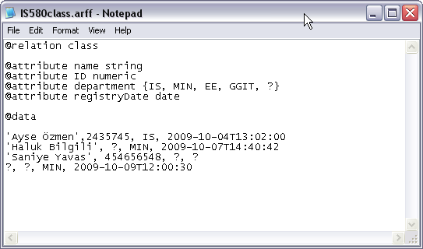
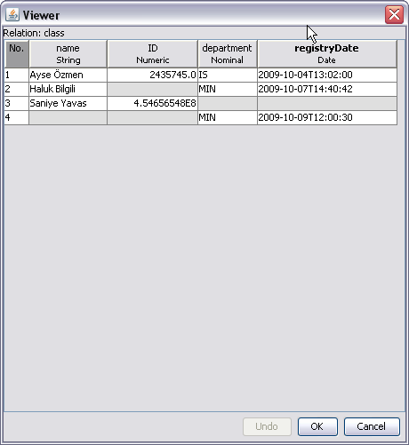
Example

Slide 41
Referances
Witten, I. H. (Ian H.) Data mining : practical machine learning tools and techniques / Ian H.Witten, Eibe Frank. – 2nd ed.
WEKA Manual for Version 3-6-0, Remco R. Bouckaert, et.all, 2008, University of Waikato.
WEKA Explorer User Guide for version 3-3-4, Richard Kirkby, 2002, University of Waikato.

